Slide 1
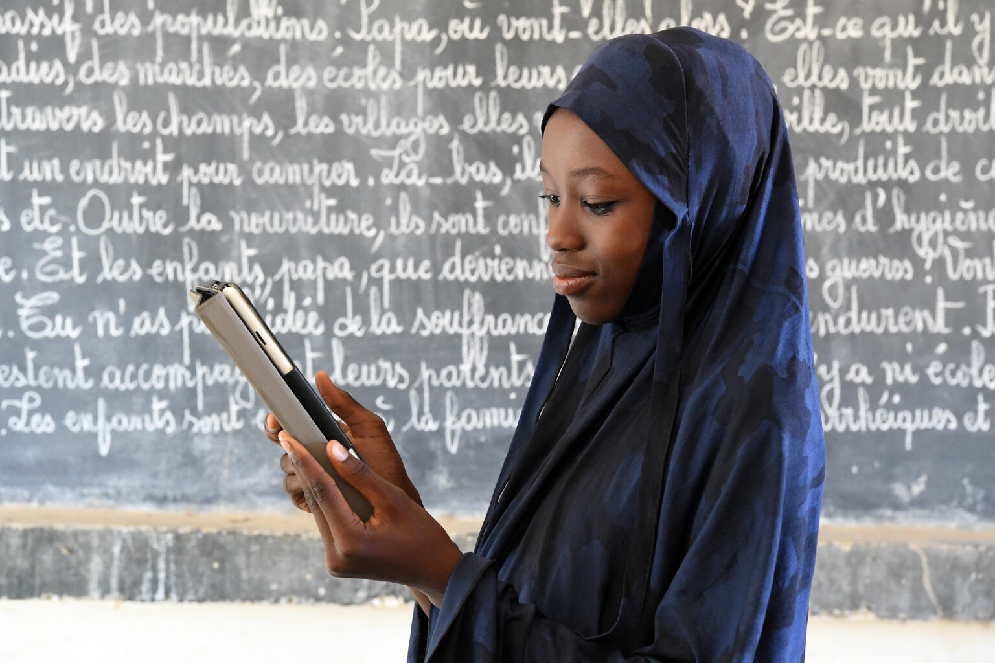
UNICEF/UN0535990

Slide 2
Slide 3 – Guess the article
Slide 4 – Introducing Article 17
Slide 5 – Exploring Article 17
Slide 6 – Some possible answers
Slides 7&8 – Primary Activities
Slides 9&10 – Secondary Activities
Slide 11 – Reflection

Slide 3
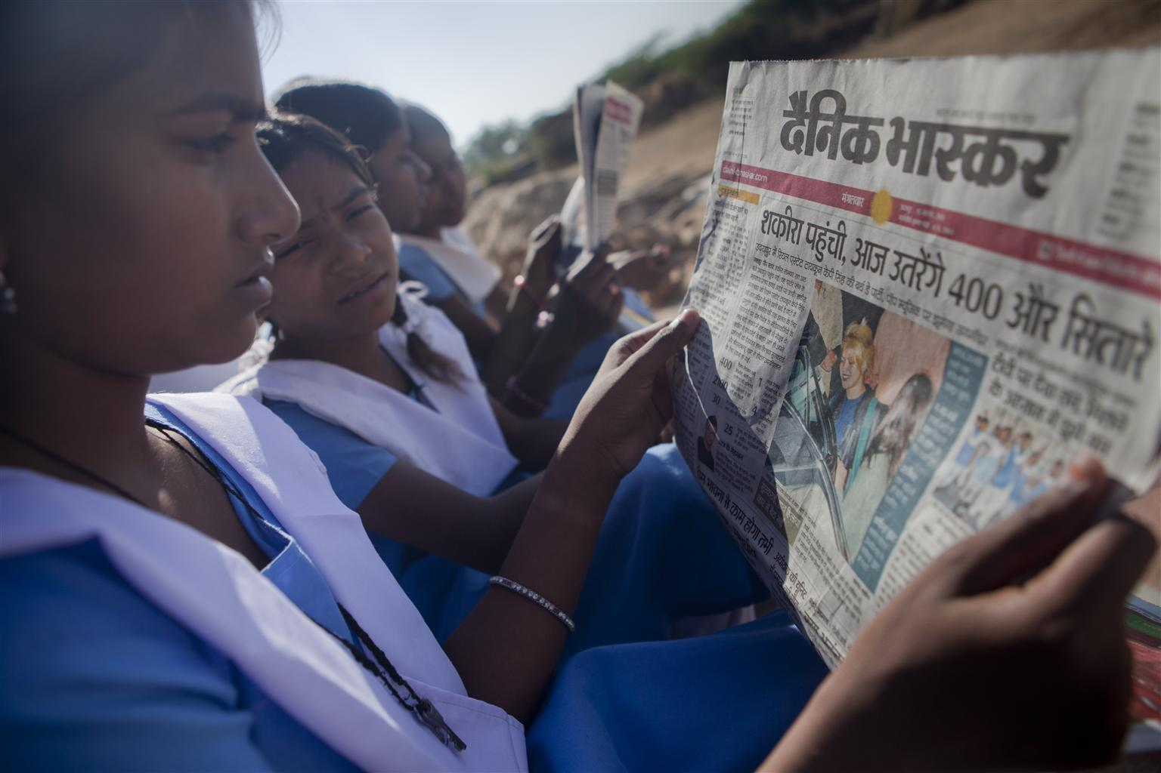
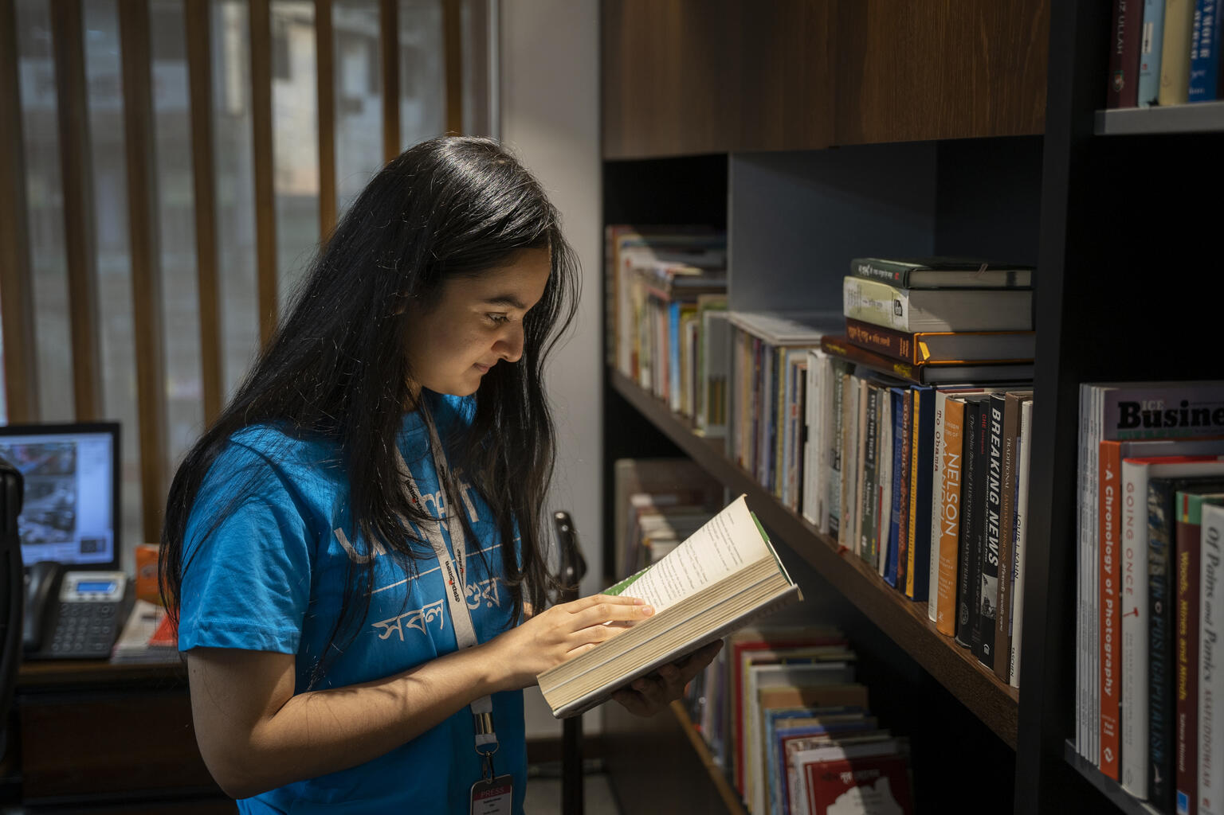

Guess the Article
These pictures provide a clue to this week’s articles.
How do these pictures help you? Can you guess how they are linked together?
Write down your thoughts or discuss with someone in your class.
@UNICEF/ Prashanth Vishwanathan
@UNICEF/ Suman Paul Himu
@Photo by Pexels

Slide 4
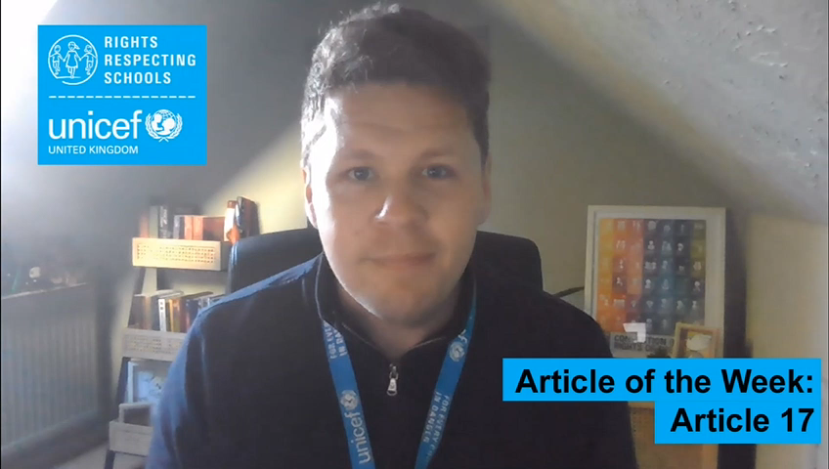

INTRODUCING ARTICLE 17
Stuart Whiffin, RRSA Professional Adviser, introduces Article 17
Article 17 (access to information from the media): Every child has the right to reliable information from a variety of sources, and governments should encourage the media to provide information that children can understand. Governments must help protect children from materials that could harm them.
Click here to watch on YouTube

Slide 5
EXPLORING ARTICLE 17
Why is it important to think about the information we receive and whether they’re reliable (can be trusted)?

Slide 6
Did you think of these?
To know that not everything you read/see/hear is true.
To help you learn about where information comes from.
To be able to discuss information you find, with people you trust.
To learn about bias and ‘fake news’.
To know that it’s OK to ask more questions if something doesn't seem right.
To be aware that people have lots of different opinions.
To learn the difference between a fact and an opinion.
To feel confident to say ‘I’m not sure if that’s true’.
To know that some people deliberately put false information online.
Did you think of anything else?

Slide 7

Watch the story of Jack and the Beanstalk. This video tells you the story from the Giant’s point of view. Imagine you are a reporter. Create a news desk in your classroom and create a news report based on the events in the story. Make sure that the report is based on facts and not opinions.
You have the right to find information in many different ways. Can you write a list or draw pictures of places or ways that you can find information?
Have a look in your school library or reading corner at the types of books you find there. They will either be fiction or non-fiction. What is the difference?
Non-fiction books in libraries are reliable places to get true information from. Can you name 5 true facts that you have learned about in a nonfiction book?
Refugee children arriving in a new country need reliable information about the town or city they have arrived in. Create a welcome pack for a new child to your school giving reliable information about what they need to know about the local area.

Slide 8
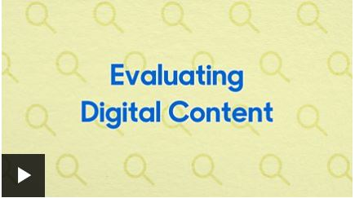
Sometimes the information we see posted online is false. Watch this video from BBC Bitesize about the reliability of digital media. Think of 5 ways you can spot if digital information is unreliable. Create a poster to put up around your school informing children how to spot misinformation.
Duty bearers must make sure that you are kept safe from harmful information. This is why there are age limits for certain games and films. Research the different categorisations used by the Government to keep children safe.
Everybody has opinions and it’s important that we are able to express those (that’s another one of your rights), but can you think about why they’re different from facts? How can you make sure the information you find out is trustworthy? Use this statement to discuss the facts and opinions relating to it: ‘Sugar is unhealthy and should be avoided.’ Can you think of other opinions you might hear of that need to be explored to make sure it is reliable information?
Social media platforms like Facebook or Instagram have minimum age limits for signup to keep children safe. Research the age limits on social media platforms and discuss as a class why these limits are in place.

Slide 9

What problems might it cause if people don’t get balanced, reliable information about important events? For example, the pandemic, climate change or elections? Our friends at The Economist Educational Foundation have prepared their own Article 17 focused resource which considers this issue in greater detail. Have a look at their free Topical Talk resource for more activities.
Try this fun BBC quiz to see if you can spot the fake news headlines. Create a poster or information sheet to help people spot misinformation.
Refugee children arriving in a new country need reliable information about the town or city they have arrived in.
Create a welcome pack for a new child to your school giving reliable information about what they need to know about the local area.
How does your school communicate with you, with families and with the wider world? Does it have a website or social media? Is the information up-to-date and of good quality?
Are children’s rights mentioned?

Slide 10
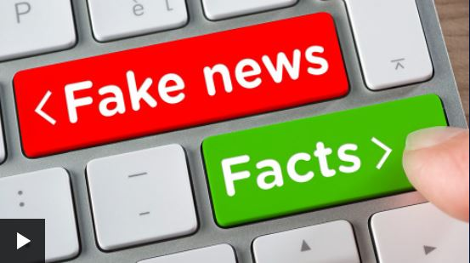
Misinformation and propaganda have been used to shape opinion for many years, but the rise of social media has brought it into greater focus. Watch this BBC Newsround report on spotting misleading stories about Ukraine crisis and put together your own top tips to help friends and family.
Everybody has opinions and it’s important that we are able to express those (that’s another one of your rights), but can you think about why they’re different from facts?
Trusted organisations can help you get the information you need to live a full and happy life. Young Scot provides information written especially for young people in Scotland on all sorts of important topics – this article sets out how they make sure they respect Article 17 - your right to reliable information. Find another article on the site that interests you and turn it into a poster to help friends and family too.
George Orwell’s 1984, set in a dystopian world overseen by Big Brother, contains the line, “Who controls the past, controls the future: who controls the present, controls the past.”
Thinking about your right to reliable information, consider the meaning of that quote in a group discussion or a discursive essay.

Slide 11
REFLECTION
Article 17 is an important article which can be linked with many other articles in the UNCRC.
If access to reliable information is important to you, think of ways you can develop this across your whole school. Maybe start up a school newspaper, radio station or YouTube Channel?
Keep in mind the activities you have just completed when sending out information to your peers and community, ensuring its reliability.
UNICEF UK/Dawe

Slide 12
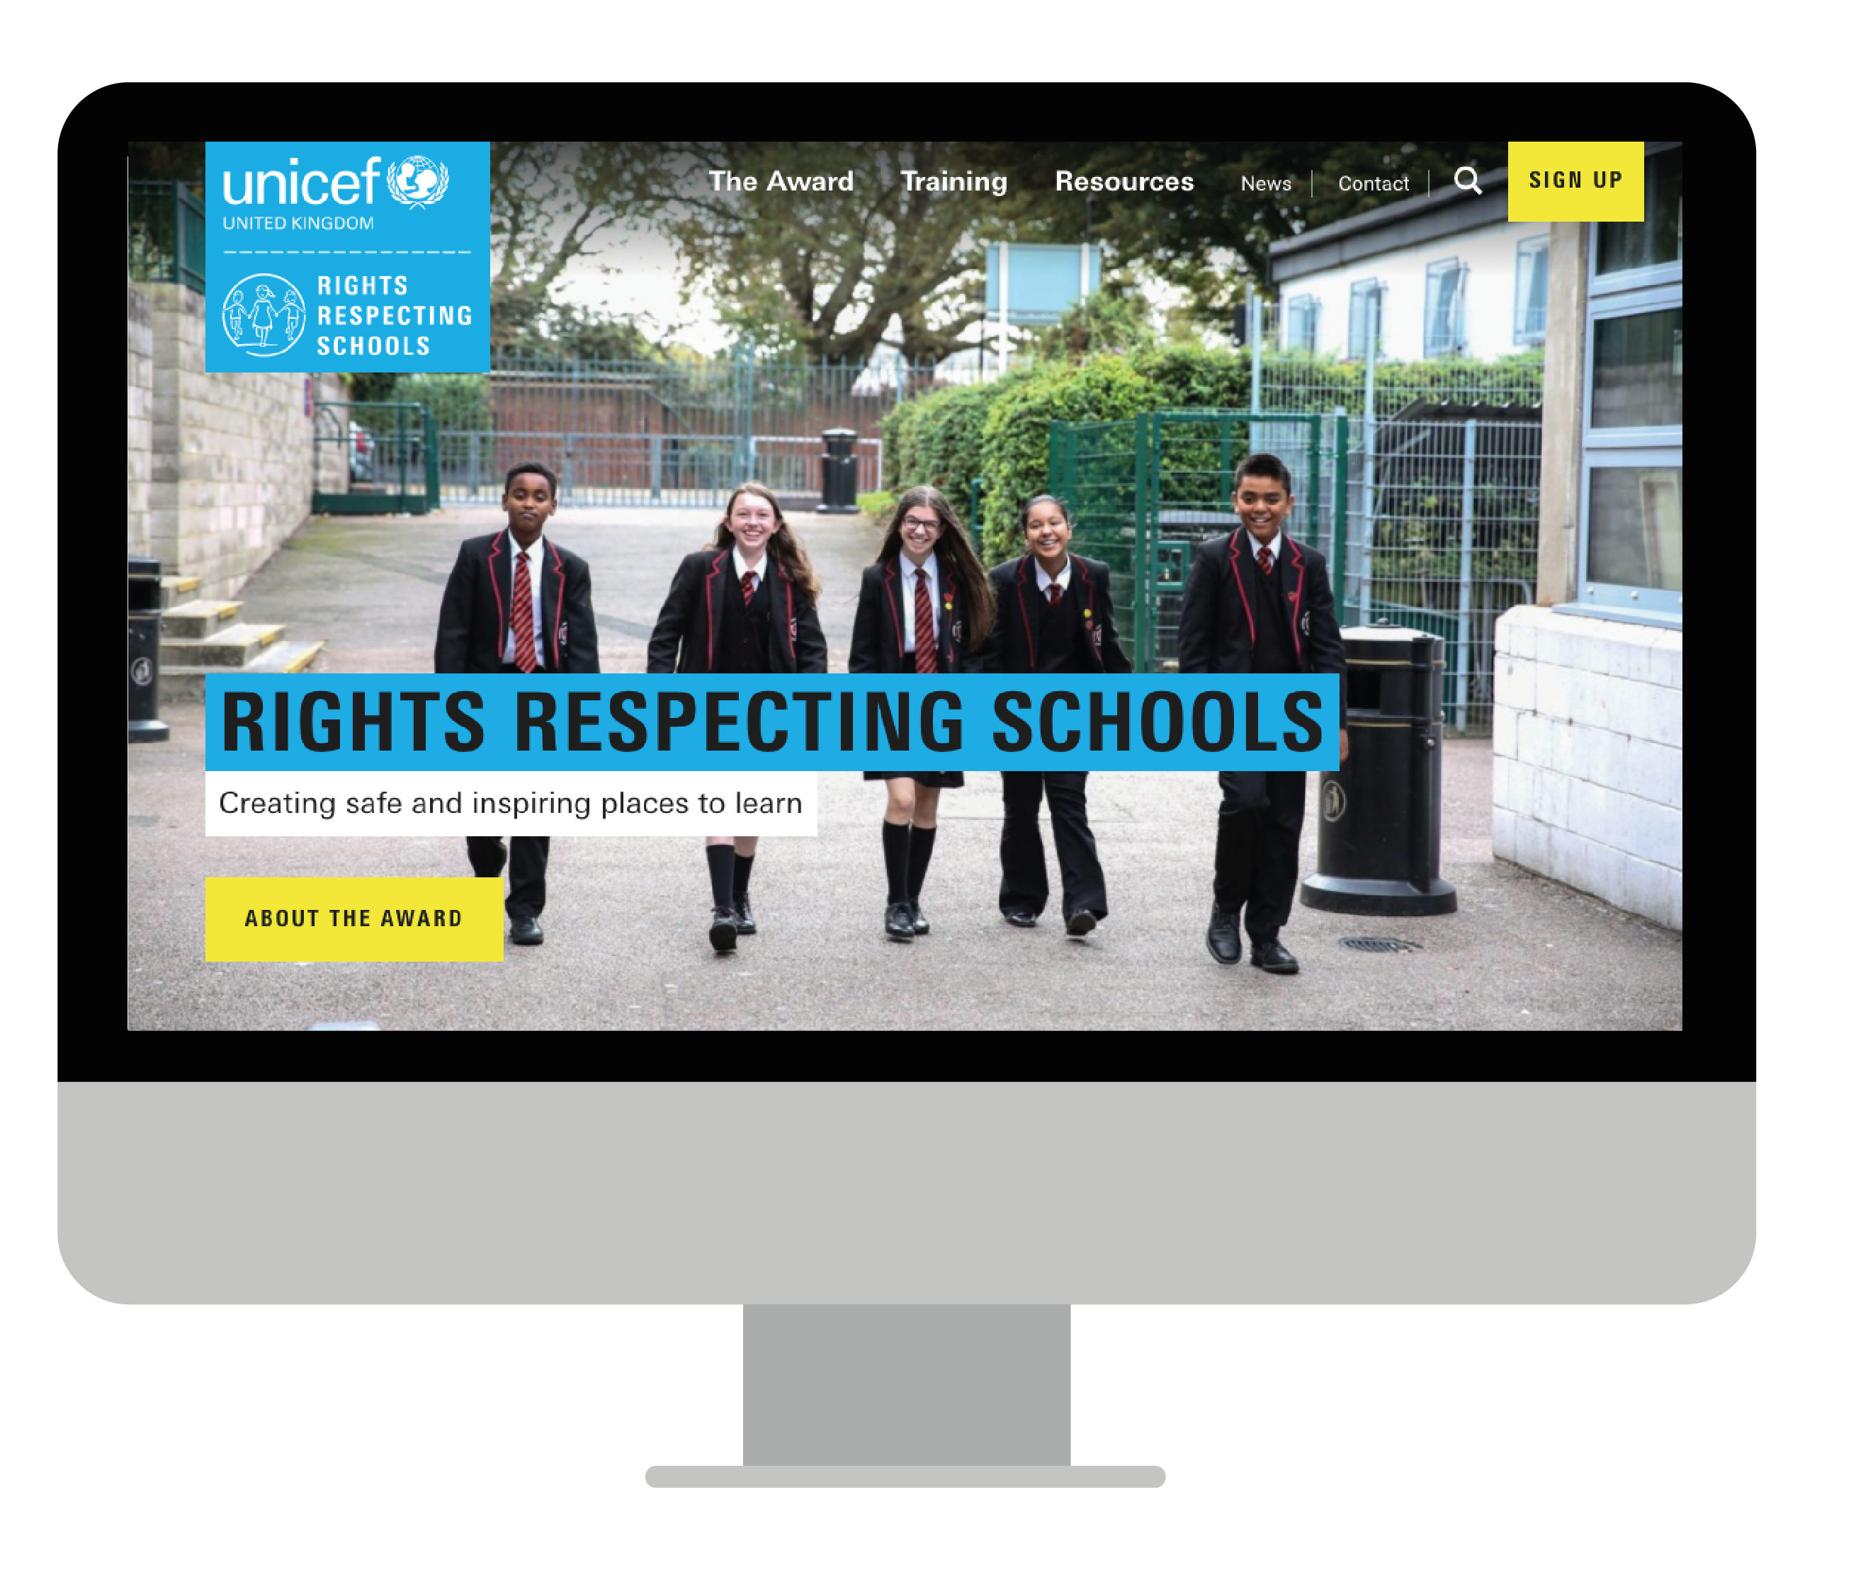
MORE INFO…
RRSA WEBSITE
For more information or to download previous Article of the Week packs please visit the RRSA website by clicking the link below
CLICK HERE

Slide 13
Thank you
UNICEF UK/Dawe
Notes:
UNICEF UK/Dawe

