Slide 1
ARTICLE OF THE WEEK
Notes:
Warsaw, October 2022. Oleksii (left), whose infectious energy ensures he’s always surrounded by his peers, came to Poland with his parents and his 16-years old brother. He attends the centers’ activities on a daily basis which has helped him not only to improve his academic performance and Polish language skills, but more importantly has made him feel like he’s part of a loving and caring community. © UNICEF/Jurkiewicz

Slide 2
INSTRUCTIONS
Slide 3: Guess the article
Slide 4: Introducing Articles 26 & 27
Slide 5: Exploring Articles 26 & 27
Slide 6: Some possible answers
Slides 7, 8 & 9: Primary activities
Slides 10, 11 & 12: Secondary activities
Slide x: Reflection

Slide 3
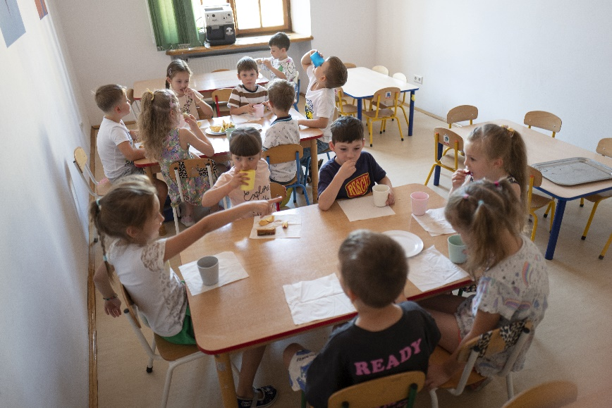
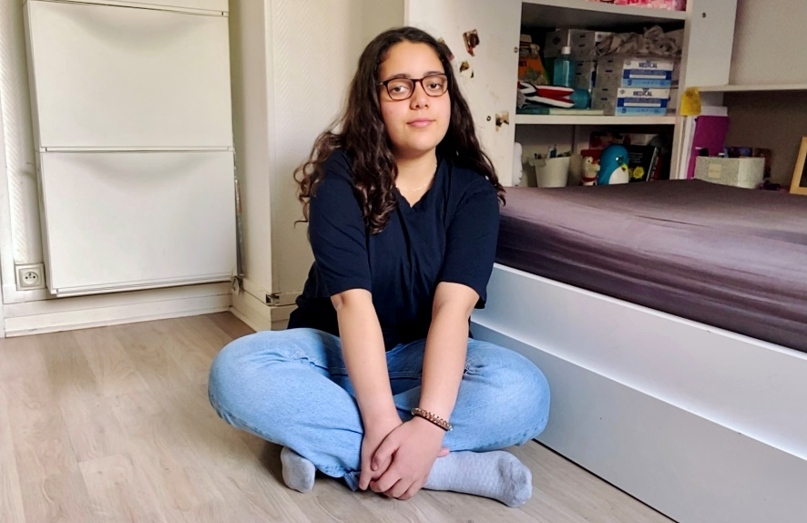
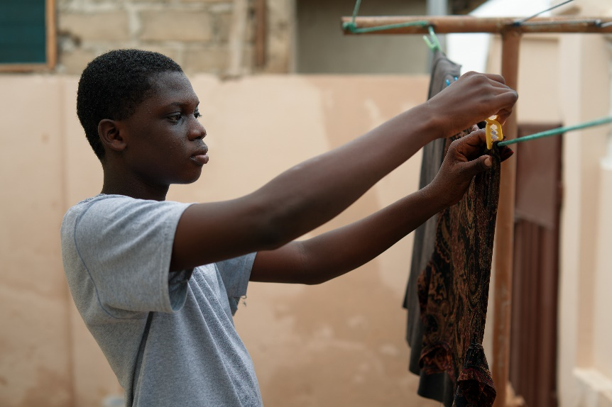
GUESS THE ARTICLE
@UNICEF/Korta
@UNICEF/Gelman
@UNICEF/UN0654521
These pictures provide a clue to this week’s articles.
How do these pictures help you? Can you guess how they are linked together?
Write down your thoughts or discuss with someone in your class.
Notes:
1. On 12 August 2022, refugee children from Ukraine eat lunch at a day care center supported by UNICEF in Krakow, Poland. UNICEF/Korta
2. On 29 April 2021, Yasmeen, 13, sits in her bedroom in Paris. UNICEF/Gelman
3. On 7 April 2022 in Accra, Ghana, 14-year-old Emmanuel hanging wet clothes on his patio. UNICEF/UN0654521

Slide 4

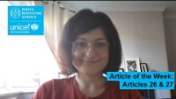
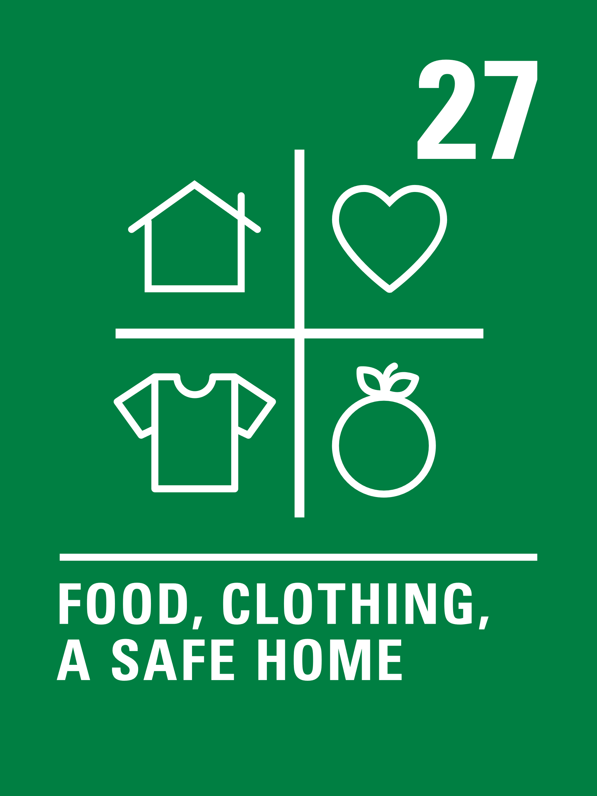
ARTICLE 26 & 27
Article 26 (social security)
Samantha Bradey, Communications, Resources and Stewardship Manager introduces Articles 26 and 27
Every child has the right to benefit from social security. Governments must provide social security, including financial support and other benefits, to families in need of assistance.
Article 27 (adequate standard of living)
Every child has the right to a standard of living that is good enough to meet their physical and social needs and support their development. Governments must help families who cannot afford to provide this.
Click here to watch on YouTube

Slide 5
EXPLORING ARTICLES 26 & 27
Give yourself one minute to think of as many answers as you can to the question below.
What are the basic things that every child needs in order to have a good standard of living?

Slide 6
EXPLORING ARTICLES 26 & 27
Did you think of these?
A safe, warm and dry place to live
Nutritious food
Clean water to drink
Somewhere to wash
Clean clothes to wear
Space, time and resources to relax and play
Healthcare and medical treatment
Education and the chance to develop your talents
A chance to have friends
People to look after you
Enough money for the essential things in life
What else did you think of?

Slide 7
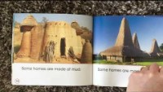

PRIMARY ACTIVITIES
You do not need to complete every activity but if you have time, you can try to complete more than one.
Around the world, people live in all sorts of different homes. Research different types of homes and discuss or watch this video. What would your ideal home look like? Draw a picture and label the important elements.
Explore Article 26 & 27 in your class. Draw images or find items that represent Article 26 and Article 27 or write a poem or story about why everyone should have a good enough standard of living.
Read The Invisible by Tom Percival. Discuss reasons why Isabel feels invisible. How can we make sure that everyone feels seen?
What do we all need to have a good enough life (Article 27)? Choose a teddy or character and talk about what it needs to enjoy a good enough standard of living. Draw pictures of all the things your character needs in life.

Slide 8

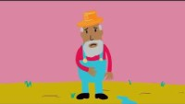
PRIMARY ACTIVITIES 2
You do not need to complete every activity but if you have time, you can try to complete more than one.
Find out about your local foodbank and learn more about their work. You could contact them and ask them to come into school. Create a poster raising awareness of food banks and encouraging people to donate. Ask your local supermarket or shops if they will display your posters.
In recent years foodbanks have seen a huge demand for their services and are supporting children and families across the UK who are struggling to afford enough food. Read or listen to the book ‘It’s a no money day’ by Kate Milner. How can you help families in your community that need support?
Watch this animation about the Sustainable Development Goal – No Poverty. Note down what the causes of poverty worldwide are… then discuss in class and create a display to show what you have learnt.
Read about these Rights Respecting Schools who have set up a swop shop to support families. Could your school do something similar?

Slide 9
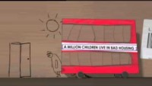
PRIMARY ACTIVITIES 3
You do not need to complete every activity but if you have time, you can try to complete more than one.
The government provides free schools meals for many children.* Discuss why you think the government does this – link your discussion to articles 26 and 27. Does it link with other rights too? During the pandemic, footballer Marcus Rashford campaigned for the UK government to provide support for families over holiday periods. Find out more about this campaign.
* this varies depending where you are in the UK
Schools have been given guidance on school uniforms in order to keep costs down for families. How much does the uniform cost for your school? Find out if there anything that your school does to help families with the cost of uniforms? Discuss whether more could be done.
Watch this animation about the life of two sisters, Chantelle and Keona. Is their house good enough to support their needs? What could the government do to support their family?
Articles 26 and 27 have some challenging vocabulary. Look up the following terms and do some research to find out what they mean. SOCIAL SECURITY - BENEFITS
STANDARD OF LIVING
Present what you find out to your class.

Slide 10
SECONDARY ACTIVITIES
You do not need to complete every activity but if you have time, you can try to complete more than one.
The government provides schools meals for many children. Discuss why you think the government do this – link your discussion to articles 26 and 27. In Wales, all primary aged pupils can now have a free school meal. Read the information here. Do you agree with this idea?
Read this article about child poverty in the UK from the Children’s Society and take a look at this map to find out about the levels of child poverty where you live. Using these resources as a starting point, research and present the facts about child poverty in the UK to your class.
The Child Poverty Action Group worked with the London College of Communication to show what it is like to live in poverty in the UK. View some of the animations here.
Which one do you find most powerful? Create your own animation or write your own story to show the impact of living in poverty.
Foodbanks are now commonplace in our communities and they work hard to ensure that everyone has enough to eat. However, some people argue that we shouldn’t need food banks if people were offered sufficient social security. Carry out research and hold a debate to ask whether food banks should exist in our societies.

Slide 11
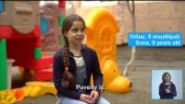
SECONDARY ACTIVITIES 2
You do not need to complete every activity but if you have time, you can try to complete more than one.
Watch this video showing children talk about poverty. How does living in poverty impact on other rights that all children have?
What does ‘social security’ mean? In your part of the UK, what does the government do to support families to make sure there is an adequate standard of living.
Thinking of a recent book you read at school, consider whether the main character(s) had an adequate standard of living. What helped or hindered?
Did they/their family receive any Government assistance?
Explore the lives of people around the world living on different amounts of money. How much money do you think people need each day to live on a day to meet children’s needs to an adequate standard? Try to find out the meanings of the terms ‘absolute poverty’ and ‘relative poverty’.

Slide 12
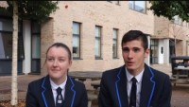
SECONDARY ACTIVITIES 3
You do not need to complete every activity but if you have time, you can try to complete more than one.
Watch this UNICEF video showing the story of Nyamiti from Malawi. SDG Goal1 is about ending poverty. What can governments around the world do to work towards this goal? Who could you contact to find out more about what commitments governments have made and whether they are sticking to them?
Have a go at this budgeting game. Did you manage to make your money stretch? For some families it isn’t a fun game, it’s something they have to work hard at every single day and sometimes it’s pretty much impossible. Do you think that’s fair? Can your class take action to raise awareness?
Have you heard of the National Minimum Wage? The Living Wage? The ‘real’ Living Wage? Do a bit of research on the difference between them (this page might help) and prepare a presentation for your class or year group.
The Child Poverty Action Group encourages schools to think about the real ‘Cost of the School Day’. This video explains one school’s work on uniform. You can also look at this Newsround report. As a class, discuss the pros and cons of uniform. What more could your school do to help families who struggle to afford uniform?
Make some suggestions to your School Council.

Slide 13
REFLECTION
Take some time to think about and reflect on articles 26, social security, and 27, adequate standard of living…
Children living in poverty are often denied their right to the basic items they need to survive and develop under Article 27. Reflect on the following:
How could the government help children living in poverty?
How could your school help children living in poverty?
If you know somebody living in poverty, how can your words and actions help to respect their dignity and rights?

Slide 14

MORE INFO
RRSA WEBSITE
For more information or to download previous Article of the Week packs please visit the RRSA website by clicking on the link below.
CLICK HERE

Slide 15
THANK YOU

