Slide 3
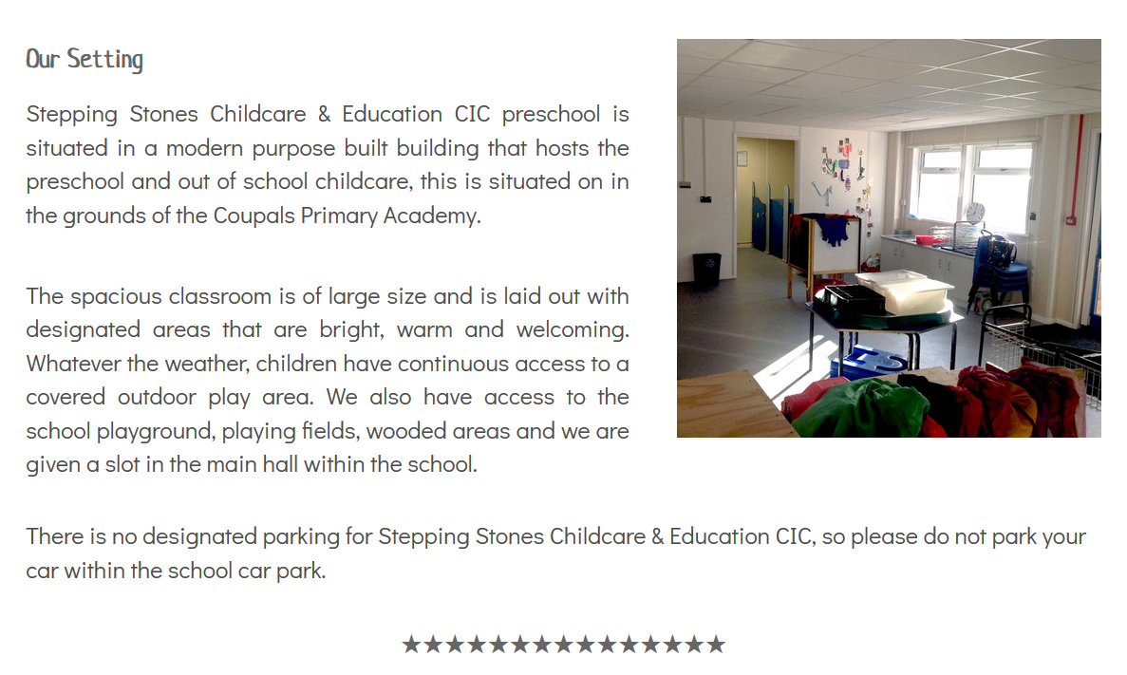

Slide 4
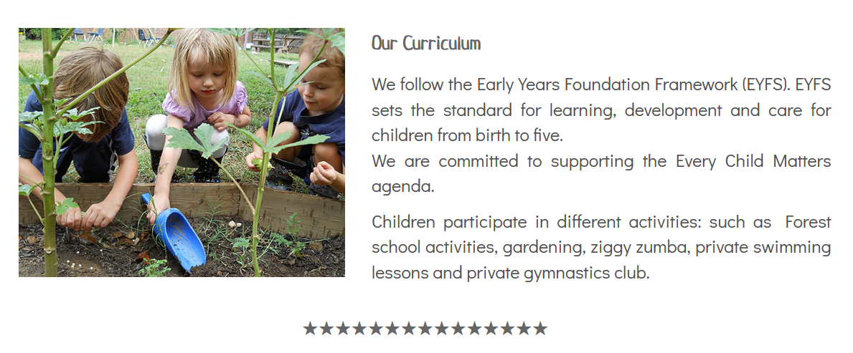

Slide 6
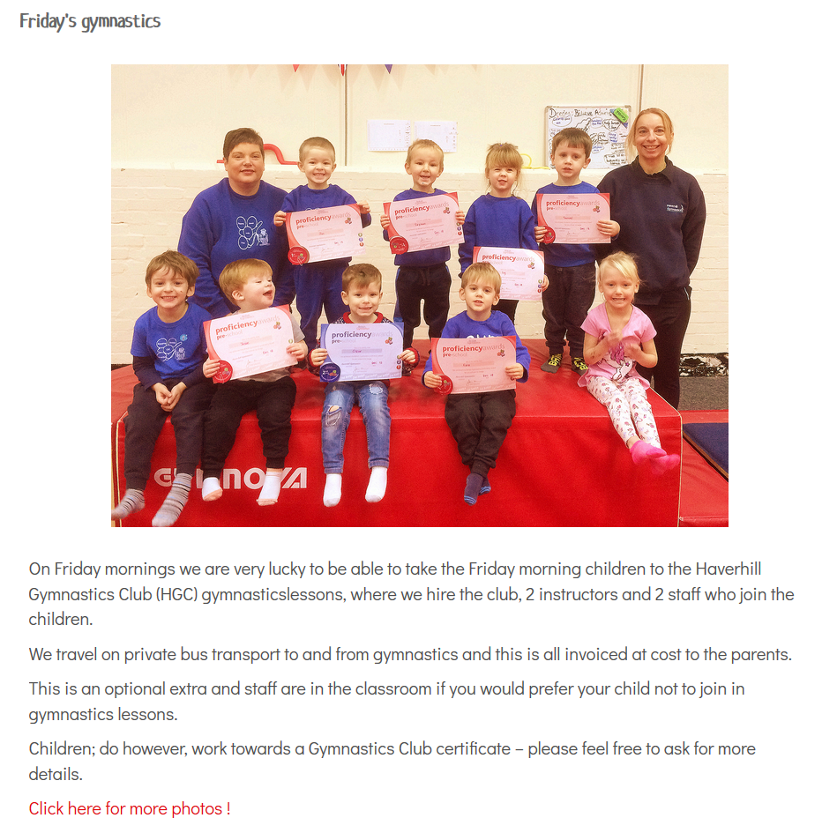

Slide 7
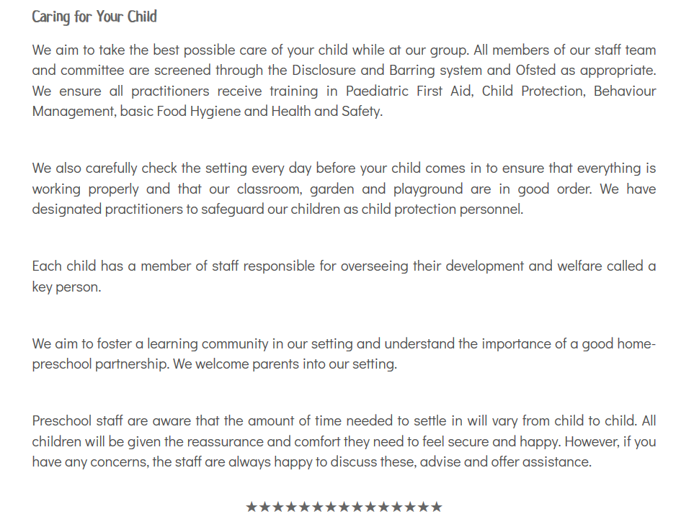

Slide 9
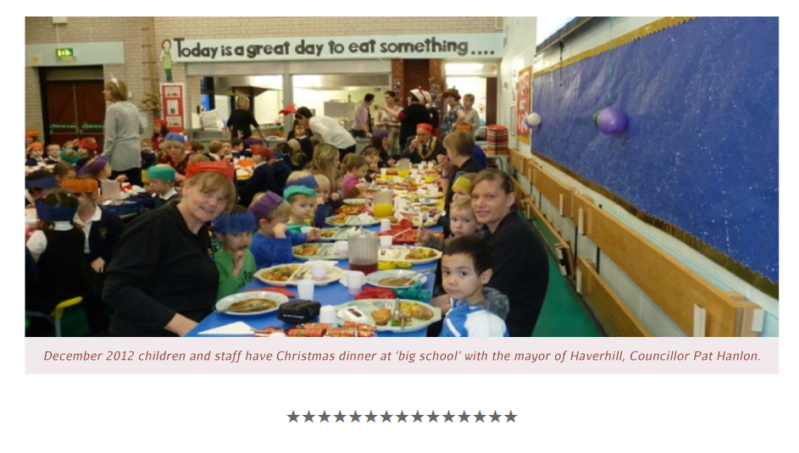

Slide 10
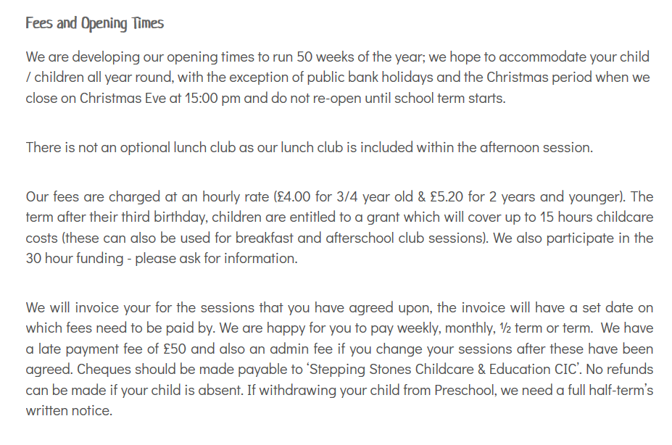

Slide 11
Below section are section removed (old photo detected)
All the grey background slide are the section that been removed on 19/12/2018.
If you want to keep it, just fill the background white and drag it into the arrangement.

Slide 12
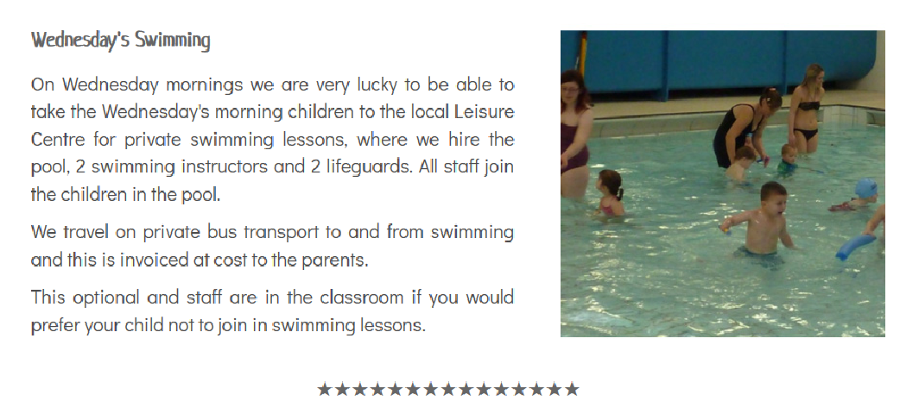

Slide 13
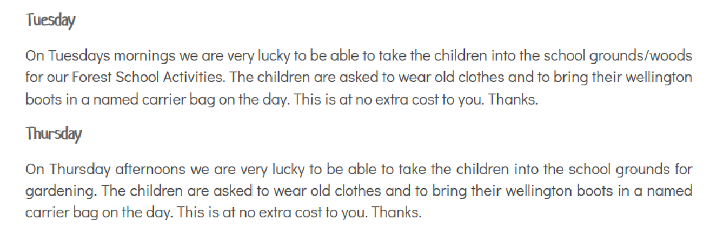

Slide 14
